Slide 1

Maya Commands
Kristine Middlemiss, Developer Consultant
Autodesk Developer Network (ADN)

Slide 2

Agenda
Custom Commands
Error Handling and Debugging
API Command Utilities
DAG Hierarchy

Slide 3
API extend Script functionality
Maya GUI
Custom Maya Command
Maya Commands
Maya API
Maya Core
OS
Notes:
For example API can create custom MEL cmds if maya’s mel commands don’t fit your need. (Since Maya doesn’t differentiate between standard features and new features added by API,) you can use this new command the same as normal MEL commands.

Slide 4
Maya Command Architecture
Maya Command Architecture is language neutral
Favours shell-style languages
Maya Commands natively bound to Python
No Python-MEL translation

Slide 5
Maya Command Parameters
Users can specify parameters to a Maya command in two ways:
Command Flags and Flag Arguments
Command Arguments
Example: headsUpDisplay –s 0 –b 0 –label “myHUD” myHUD;
Basic command structure:
myCommand –myFlag <optionalFlagArg> <optionalCmdArg>
Can have multiple flags, flag arguments and command arguments.
Notes:
Since we are going to create our custom MEL command, we will first analysize the different features of MEL commands.

Slide 6
Maya Command Undo/Redo
Maya commands support an undo/redo framework
The undo/redo queue can be:
Turned off
Have a limited size
Have an infinite size
Defined in ‘Settings and Preferences’
While a command sits on the undo/redo queue, it retains all of its parameters, operations and data.
Has implications when creating your own custom commands, particularly for those that store data: The lifetime of a command and associated data is dependent on the settings of the undoQueue.

Slide 7
Maya Command Undo/Redo
Maya Command History
Undo Queue
Redo Queue
create a sphere
create a sphere
translate in x axis
scale in z axis
scale in z axis
scale in z axis
translate in x axis
translate in x axis
undo
undo
redo

Slide 8
Custom Command
Extend Maya Command
Core Class: MPxCommand
Related Classes: MArgList, MSyntax, MArgDatabase

Slide 9
Custom Command Structure
Example Class Declaration:
class myCmd : public MPxCommand
{
public:
myCmd();
virtual ~myCmd();
static void* creator();
MStatus doIt(const MArgList&);
};

Slide 10
MPxCommand Registration
To register your custom command in Maya:
To deregister your custom command:
MStatus initializePlugin(MObject obj)
{ MFnPlugin plugin(obj, “Autodesk”, “1.0”, “any”);
MStatus status = plugin.registerCommand(“myFirstCmd”, myFirstCmd::creator);
return status; }
MStatus uninitializePlugin(MObject obj)
{ MFnPlugin plugin(obj);
MStatus status = plugin.deregisterCommand( “myFirstCmd”);
return status; }

Slide 11
Custom Command Registration
The creator method is called to return a new instance of the command
void* myFirstCmd::creator()
{
return new myFirstCmd;
}

Slide 12
Custom Command: myFirstCmd
A standard custom command plug-in: myFirstCmd
Notes:
Give trainee a taste of what a command plug-in is and how it works:
2. Show trainee how to implement step by step using plug-in wizard

Slide 13
Custom Command with Undo/Redo
doIt (const MArgList& args)
Called when command is executed. Parse the “args” arguments and perform user-defined operation
isUndoable()
Override this method to return true/false to denote if this command support undo/redo
undoIt()
Called by “undo” command
redoIt()
Called by “redo” command
Notes:
doIt() : The doIt() method performs the actions of the command. In more complex commands, the doIt() method parses the argument list, the selection list, and whatever else may be necessary. It then uses this information to set data internal to the command before calling the redoIt() method, which does the bulk of the work. This avoids code duplication between the doIt() and redoIt() methods. Called on command execution
redoIt() : This method should do the actual work (if available) of the command based on the internal class data only. Internal class data should be set in the doIt method. Called on command redo
isUndoable() : used to specify whether or not the command is undoable. False by default. Overwrite to return True if you want Maya to undo the command
undoIt() : Override with the undo functionality to reverse the redoIt() functionality

Slide 14
Custom Command Structure
Example Class Declaration
class myCmd : public MPxCommand
{
public:
myCmd();
virtual ~myCmd();
static void* creator();
MStatus doIt(const MArgList&);
MStatus redoIt();
MStatus undoIt();
bool isUndoable() const;
};

Slide 15
Command with Arguments
MArgList class:
This class is used to create and hold the list of arguments that are passed to a command.
From this class, the parameter flags and the values of flag arguments can be retrieved.

Slide 16
Command with Arguments
Retrieve arguments from MArgList
myCmd -number 10;
MStatus MyCmd::doIt(const MArgList& args)
{
//get the index for the flag "number"
unsigned index = args.flagIndex("n","number");
int numArg;
if(MArgList::kInvalidArgIndex!=index)
//get the data following flag "n"
args.get(index+1, numArg);
}
Notes:
Let’s say for example, you add a flag onto your command “number” and the flag argument is 10
If the flag is valid, then the argument following the flag is retrieved. This argument is at index+1.

Slide 17
Command with Arguments
custom syntax: more advanced and flexible way to define and parse arguments
Three types of arguments that can be specified via these syntax methods: flags arguments, command arguments, objects
MSyntax class represents a command syntax definition.
You are responsible to define a syntax constructing method that must be registered with Maya for your command.

Slide 18
Custom Command Structure
Example Class Declaration
class myCmd : public MPxCommand
{
public:
myCmd();
virtual ~myCmd();
static void* creator();
MSyntax newSyntax();
MStatus doIt(const MArgList&);
MStatus redoIt();
MStatus undoIt();
bool isUndoable() const;
};

Slide 19
MSyntax
Syntax registration:
MFnPlugin::registerCommand(“myCmd”, myCmd::creator, myCmd::newSyntax);
Syntax definition:
#define cFlagShort “-str”
#define cFlagLong “-string”
MSyntax myCmd::newSyntax()
{
MSyntax syntax;
// Disable edit and query flags
syntax.enableEdit(false);
syntax.enableQuery(false);
// Add flags
syntax.addFlag( cFlagShort, cFlagLong, MSyntax::kString );
return syntax;
}

Slide 20
MSyntax
Retrieve Arguments:
MPxCommand::syntax()
MStatus myCmd::doIt(const MArgList &args)
{
MString argString = “ ”;
MArgDatabase argData( syntax(), args );
if( argData.isFlagSet( cFlagLong) )
argData.getFlagArgument(cFlagLong, 0, argString);
if (argData.isFlagSet(cFlagShort))
argData.getFlagArgument(cFlagShort, 0, argString);
}

Slide 21
Help on Custom Command
Automatic Help
help myCmd;
Adding your custom help
#define helpFlagShort “-h”
#define helpFlagLong “-help”
const char * helpText = “\nThe myCmd command is used to …..”
MSyntax myCmd::newSyntax()
{
syntax.addFlag(helpFlagShort , helpFlagLong);
}
MStatus myCmd::doIt(const MArgList &args)
{
MArgDatabase argData( syntax(), args );
if( argData.isFlagSet(helpFlagShort ) )
{
setResult( helpText );
return MS::kSuccess;
}
}

Slide 22
Example: nodeInfoCmd
In this exercise, we will implement a custom command nodeInfoCmd, with an option to specify a flag “-quiet”. By default, for all the selected nodes in the scene, it will print out all the node types and connected plugs information and also the node which is connecting to this selected node as a source. If “-quiet” is provided by user, the command will only print out the selected node type.
Important Classes: MPxCommand, MSyntax, MArgDatabase, MFnDependencyNode and MPlug

Slide 23
Utilities API: MGlobal
Query and set global settings (time, z-up, selection masks, etc..)
Query what is selected or highlighted
Display command warnings and errors
Interaction with script languages

Slide 24
Utilites API: MGlobal
Query and set global settings (time, z-up, selection masks, etc..)
MGlobal::mayaState(MStatus * returnStatus)
MGlobal::viewFrame ( const MTime & time )
MGlobal::setSelectionMode ( MGlobal::MSelectionMode mode)
MGlobal::setYAxisUp (bool rotateView)
Etc…

Slide 25
MGlobal & Selection List
MSelectionList: class representing a list of MObjects
Used for more than just what is selected, e.g.
Highlight list
Query / Modify list membership
MItSelectionList:class for iterating over the items in an MSelection list. A filter can be specified so that only those items of interest on a selection list can be obtained.
MGlobal::getActiveSelectionList(MSelectionList &dest);
MGlobal::getSelectionListByName ( const MString & name, MSelectionList & list )
MGlobal::setActiveSelectionList( const MSelectionList & src, MGlobal::ListAdjustment )

Slide 26
MGlobal Selection
MGlobal::select ( const MDagPath & object, MGlobal::ListAdjustment listAdjustment )
add an object to the active selection list without creating an MSelectionList first
MGlobal::selectByName(const MString & name, MGlobal::ListAdjustment listAdjustment )
finds all objects matching a pattern and adds them to the active selection list
MGlobal::setActiveSelectionList ( const MSelectionList & src, MGlobal::ListAdjustment )
Set the active selection list. The selection items on the given list will update the contents
of the active selection list as indicated by the listAdjustment parameter.
MGlobal::selectCommand ( const MSelectionList & src, MGlobal::ListAdjustment )
Set the active selection list, by calling the built in Maya select command
MStatus MGlobal::selectFromScreen ( const short & x_pos, const short & y_pos, MGlobal::ListAdjustment, MGlobal::SelectionMethod )
Perform click-pick type selection. If an object intersects the click point then it is
selected according to listAdjustment.

Slide 27
Utilities API: MGlobal
Display error/warning messages or general information to the user for custom command
void MGlobal::displayInfo ( const MString & theMessage )
void MGlobal::displayWarning ( const MString & theWarning )
void MGlobal::displayError ( const MString & theError )

Slide 28
Utilities API: MGlobal
Execute MEL script:
MGlobal::executeCommand(const MString &command)
MGlobal::sourceFile
Execute Python Command:
MGlobal::executePythonCommand (const MString &command)
//execute mel command to create a nurbs sphere
MGlobal::executeCommand( "sphere" );
// execute the specified mel script MGlobal::sourceFile( "C:\\MyScripts\\testScript.mel" );
//execute python command to create a poly cube MGlobal::executePythonCommand (“polyCube( sx=10, sy=15, sz=5, h=20 )”)

Slide 29
Error checking: MStatus
Maya API class for status codes:
MStatus::kSuccess - The operation was successful
MStatus::kFailure - The operation failed
MStatus::kInsufficientMemory - The operation failed due to insufficient memory
MStatus::kInvalidParameter - An invalid parameter was provided
MStatus::kLicenseFailure - Application is not licensed for the attempted operation
MStatus::kUnknownParameter - Returned by MPxNode::compute for unrecognised plugs
Notes:
The MStatus class can determine if a method has failed.
Many API methods either return an instance of the MStatus class, or fill in an instance passed as an optional parameter.
The MStatus class contains the methods error, and an overloaded operator bool, both of which return false if the instance is holding an error status.
Usually you go with the bool operator

Slide 30
Error checking: MStatus
Checking status codes in a macro
#define MCheckStatus(status,message) \
if( MStatus::kSuccess != status ) \
{ \
MGlobal::displayError(message); \
return status; \
}
MSelectionList slist;
MStatus status = MGlobal::getActiveSelectionList( slist );
MCheckStatus(status, “Error getting active selection list”);

Slide 31
Debug Maya plugin
Standand output
maya header files already included standard output string
Attach to Maya thread
launch Maya, load the plug-in
In Visual Studio, set breakpoints using F9
Debug -> Attach to Process
Select maya.exe and hit “Attach” button
Execute the command in script editor

Slide 32
DAG (Directed Acyclic Graph)
DAG Nodes are just DG Nodes!
Parenting are not dependency graph connections
DAG hierarchy
Node types containing transformation info:
joints (MFn::kJoint)
transforms (MFn::kTransform)
Other typical node types in a skeletal hierarchy:
shapes (nurbs, polys, …)
locators (MFn::kLocator)
Ik (MFn::ikHandle, MFn::ikEffector)
Notes:
The DAG nodes impose a top-down hierarchy due to the resulting tree structure that their parent-child relationships create.

Slide 33
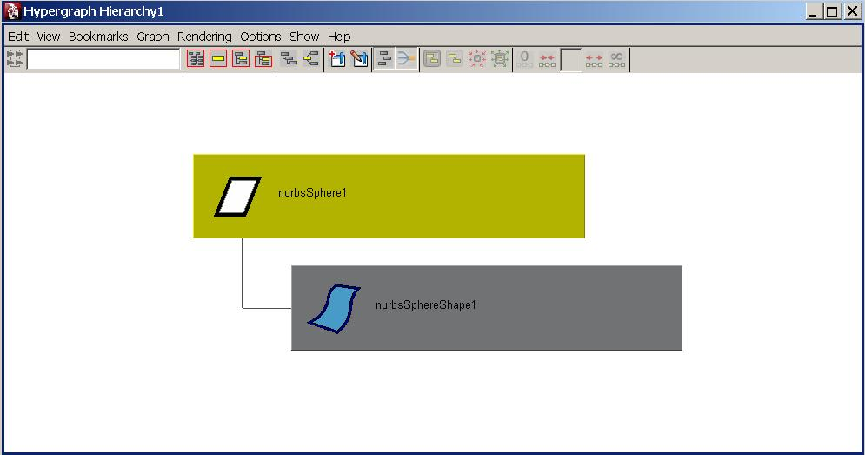
DAG Hierarchy
An Example: sphere

Slide 34
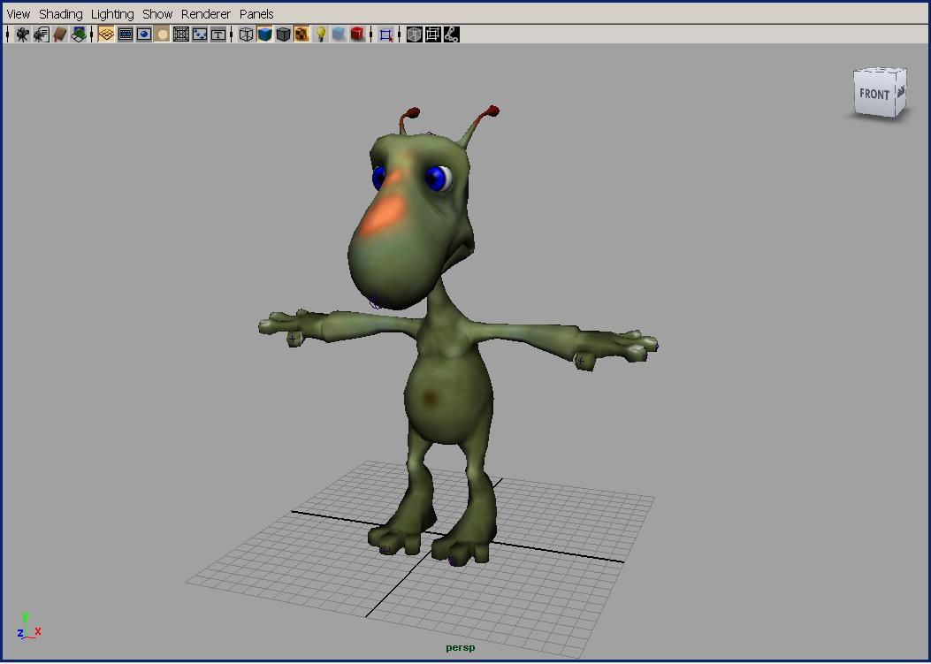
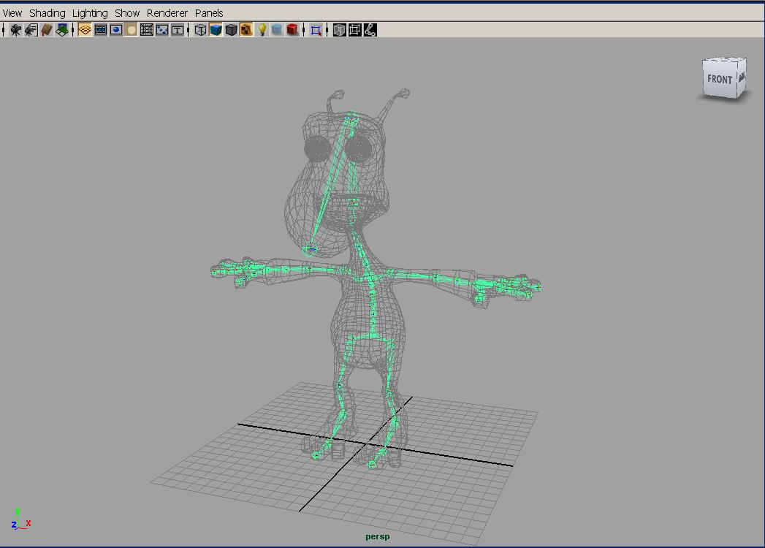
DAG Hierarchy
A More complex example: skeleton hierarchy

Slide 35
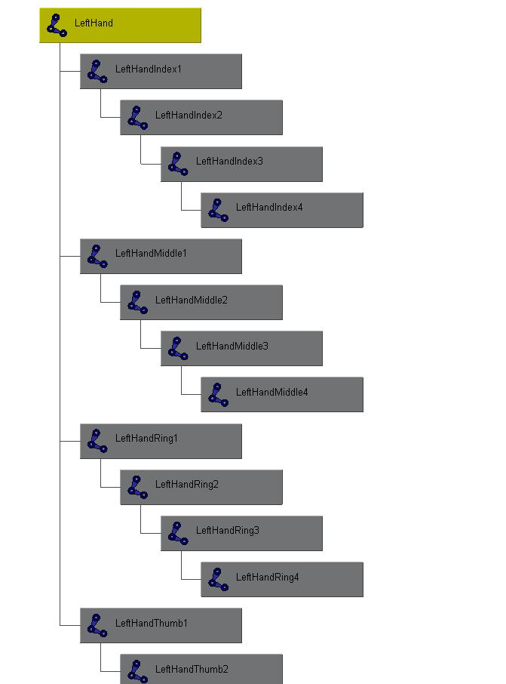
DAG Hierarchy
A More complex example: skeleton hierarchy
hip
spline
shoulder
arm
hand

Slide 36
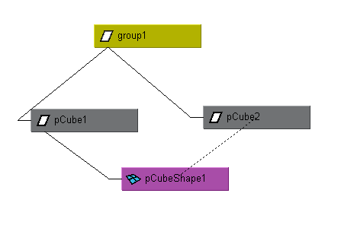
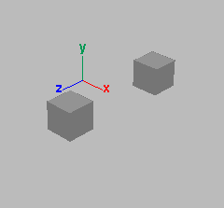
Instancing
A node may have more than one parent
A dagPath is used to identify instances
group1|pCube1|pCubeShape1
group1|pCube2|pCubeShape1

Slide 37
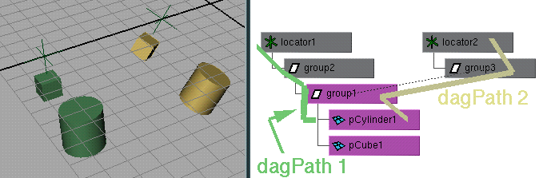
Dag Paths
used to find world space transformations
used to traverse up and down hierarchy
node names need not be unique if dagPaths are different (MDagPath fullPathName, partialPathName)

Slide 38
MObject VS. MDagPath
Many of the Maya API accept/return a MObject or a MDagPath
A MDagPath is a handle describing a path to a node
A MObject is a wrapper around a pointer to the internal Maya object
Generic class (represents all node / attribute)
Use apiType() / hasFn() to determine what it is or what you can do with it
Use isNull() to determine if it is a valid MObject
Do not store MObject

Slide 39
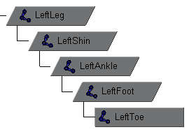
Important API methods
Traversal : MItDag iterator class
Depth in hierarchy: MDagPath::length, MItDag::depth
Getting the parent: MDagPath::pop
Local matrix: MFnTransform::transformation
World matrix: MDagPath::inclusiveMatrix, MDagPath::exclusiveMatrix …

Slide 40
Example: dagInfo
In this exercise, we will implement a custom command dagInfo. For all the selected DAG nodes in the scene, it will print out the instance information, dag path and also inclusive and exclusive matrix.
Important Classes: MFnDagNode, MDagPath MMatrix, MGlobal, MItSelectionList

Slide 41
Example: instanceRotate
manipulates the instances of a selected mesh shape by rotating them with a quarter angle every time. User can specify which axis they want the objects to move around by sending arguments to this command.
Practice note: how to handle complex plugs such as compound attribute plug
how to work with MSyntax and MArgDatabase and parse arguments
Notes:
Sometimes when you execute the command, it looks like the cylinders are not rotating, they are actually rotating, it is just the rotation angle this time is exactly the same as last time

Slide 42
Q & A

Slide 43
Autodesk

